Slide 1
SS ZG 526: Distributed Computing
Second Semester 2014-2015
Lect 15: P2P Computing
Chittaranjan Hota, PhD
Dept. of Computer Sc. & Information Systems
hota@hyderabad.bits-pilani.ac.in

Slide 2
Recap: What is a P2P Overlay?
Selfish objective
C
E
F
P2P overlay layer
A
H
D
G
B
A
C
E
F
H
AS₁
AS₄
B
AS₆
AS₂
D
Native IP layer
AS₅
Improved services
AS₃
G
SS ZG526, Distributed Computing

Slide 3
Continued…
Multiple sites (at edge)
Distributed resources
Sites are autonomous
Sites are both clients and servers
Sites have equal functionality
SS ZG526, Distributed Computing

Slide 4
Latency optimized Overlay: An example
  Overlay routing is independent of native layer routing
  Each Overlay path comprises one or more Overlay links, based on a selfish objective
A
50ms
D
20ms
20ms
B
C
SS ZG526, Distributed Computing

Slide 5
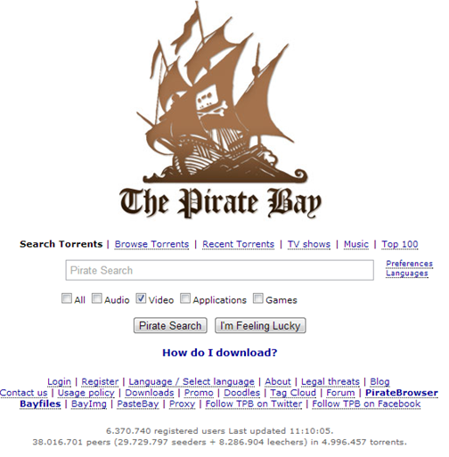
The Pirate Bay (TPB)
40% of Internet traffic in 2010
SS ZG526, Distributed Computing

Slide 6
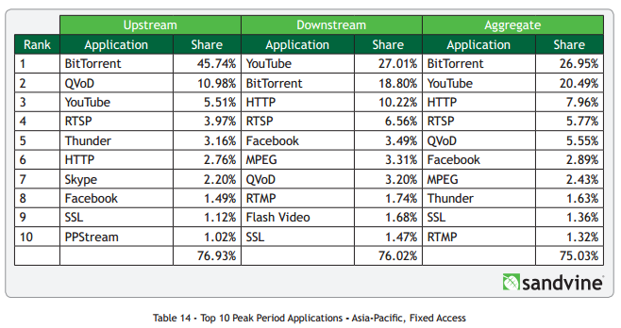
P2P Overlay: Growth
[Source: https://www.sandvine.com/downloads/general/global-internet-phenomena/2014/1h-2014-global-internet-phenomena-report.pdf]
SS ZG526, Distributed Computing

Slide 7
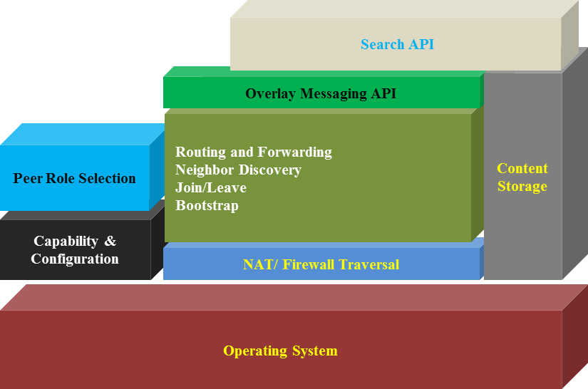
P2P Architecture
SS ZG526, Distributed Computing

Slide 8
Advantages
Efficient use of resources
Scalability:
  Consumers of resources also donate resources
Reliability
  Replicas
  Geographic distribution
  No single point of failure
Ease of administration
  Nodes self organize
  No need to deploy servers to satisfy demand
  Built-in fault tolerance, and load balancing
SS ZG526, Distributed Computing

Slide 9
Disadvantages
Decentralized coordination
  How to keep global state consistent?
All nodes are not created equal.
  Computing power, bandwidth have an impact on overall performance.
Programmability
  As a consequence of decentralized coordination
SS ZG526, Distributed Computing

Slide 10
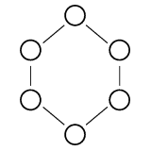
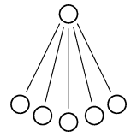
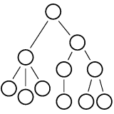
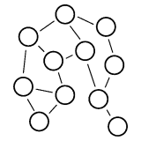
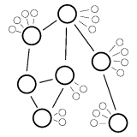
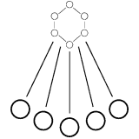
P2P Topologies
centralized
Ring
Hierarchical
Decentralized
Hybrid: Centralized + Ring
Hybrid: Centralized + Decentralized
SS ZG526, Distributed Computing

Slide 11
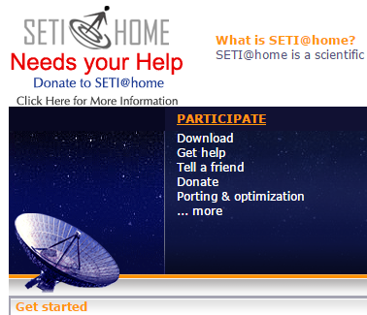
The SETI@home project
The SETI (Search for Extra Terrestrial Intelligence) project looks for patterns in radio frequency emissions received from radio telescopes that suggest intelligence. This is done by partitioning data received from telescopes into chunks and sending each chunk to several different computers owned by SETI volunteers for analysis.
Link: http://setiathome.ssl.berkeley.edu/
SS ZG526, Distributed Computing

Slide 12
Applications over P2P
Application Purpose | Purely Decentralized | Partially Decentralized | Hybrid Decentralized
Content Publishing & Storage | Freenet, PAST, OceanStore, CFS [Dabek et al. 2001]
File Sharing | Gnutella, Free Haven | Gnutella 0.6 [Gnutella 2002], Kazaa | Napster, BitTorrent
Anonymous Storage | Freenet
Communication & Messaging | Groove, SharedMind | Skype | Jabber
Backup operations | Pastiche
Infrastructure base | Chord [Stoica et al. 2001], Pastry [Rowstron and Druschel 2000], Tapestry[Zhao et al. 2003], CAN [Ratnasamy et al. 2001]
Routing | RON [Andersen et al. 2001]
Search engines | Minerva [Michel et al. 2005], ODISSEA [Suel et al. 2003]
Computation |  |  | SETI@home
Web Caching | Squirrel
Multicasting | Split Stream [Castro et al. 2003], Scribe, Bayeux[Zhuang et al. 2001]
Spam filtering | SpamWatch[Zhou et al. 2003]
Domain name lookup | DNS using Chord [Cox 2002]
Multimedia Streaming | PPLive, Coolstreaming
Intrusion Detection | Indra [Janakiraman et al. 2003]
SS ZG526, Distributed Computing

Slide 13
Commercial Applications over P2P
Application | Purpose | Company | Since
Kontiki | Hybrid peer-to-peer content distribution targeting media content | M K Capital | 2008
Skype | Voice over peer-to-peer | eBay | 2006
Groove | Collaboration without any help of central server. Known customers: Dell, Department of Defense, GlaxoSmithKline and Veridian | Groove Networks | 2001
Magi | P2P infrastructure platform for building secure, cross-platform, collaborative applications | Endeavours Technologies | 2001
Zattoo | Streaming to TV viewers over internet | Zattoo | 2006
CoolStreaming | To share television content using swarms | Roxbeam Corp. | 2005
PPTV | Live and on-demand TV service over internet | PPLive | 2005
Joost | Streaming legal videos in agreement with publishers | Adconion Media Group | 2009
SS ZG526, Distributed Computing

Slide 14
Un-structured P2P networks
Data is distributed randomly over peers
The overlay can start with centralized control and gradually shift to distributed control
No broadcasting
Flooding may generate heavy network traffic
No guarantee of a deterministic search
TTL limit on a query may reach entire network
SS ZG526, Distributed Computing

Slide 15
Structured P2P networks
Structured routing (ring, hypercube etc)
Reduced routing hops compared with random graphs
Avoid flooding and eliminate hotspots
Guarantee the search results
Provide load balancing
Provide enhanced scalability and fault tolerance
Provide enhanced security protection
SS ZG526, Distributed Computing

Slide 16
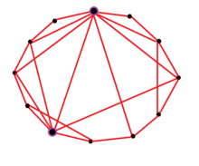
Small-world network model
A small-world network is a type of mathematical graph in which most nodes are not neighbors of one another, but most nodes can be reached from every other by a small number of hops or steps. Specifically, a small-world network is defined to be a network where the typical distance L between two randomly chosen nodes (the number of steps required) grows proportionally to the logarithm of the number of nodes N in the network, i.e.
[Source: wiki]
SS ZG526, Distributed Computing

Slide 17
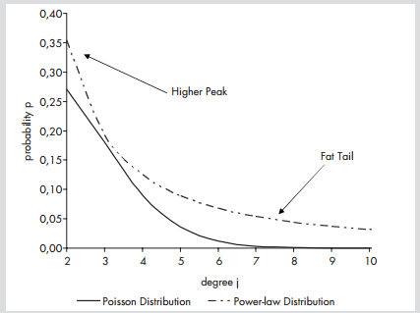
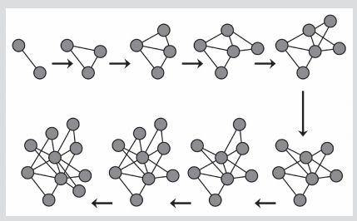
Scale-free networks
A scale-free network is a network whose degree distribution follows a power law. That is, the fraction P(k) of nodes in the network having k connections to other nodes goes for large values of k as:
Source: Oliver Hein, Michael Schwind, Wolfgang Ko¨nig
SS ZG526, Distributed Computing

Slide 18
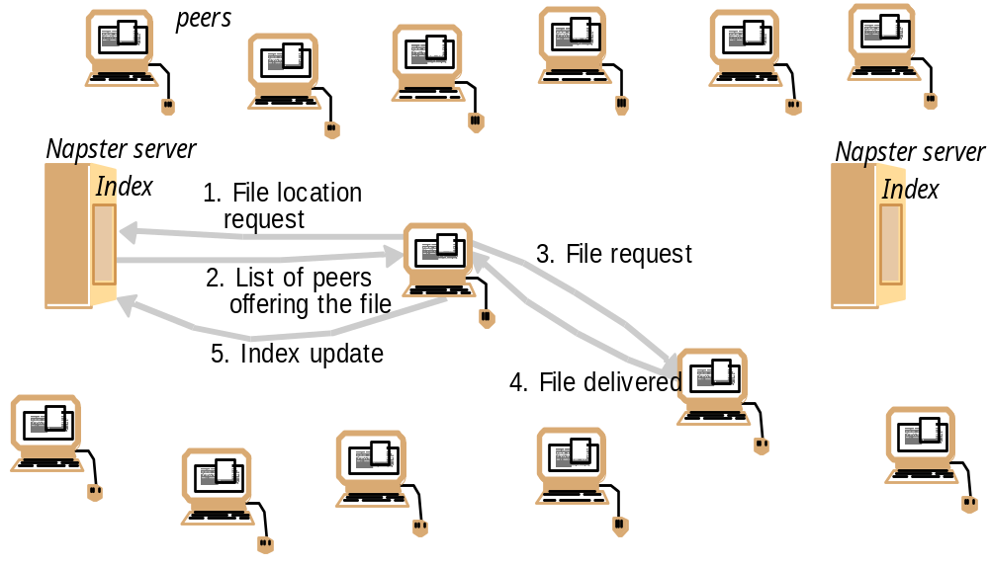
Napster: Centralized architecture
Benefits:
  Efficient search
  Limited bandwidth usage
  No per-node state
Drawbacks:
  Central point of failure
  Limited scale
SS ZG526, Distributed Computing

Slide 19


Gnutella file sharing
SS ZG526, Distributed Computing

Slide 20
Message types in Gnutella
Message Type | Description
Ping | Used for topology discovery of the network. A node receiving a Ping message is expected to respond with one or more Pong messages.
Pong | The response to a Ping message. Includes the address of a connected Gnutella node and information regarding the amount of data it is making available to the network.
Query | The primary mechanism for searching the distributed network. Query message includes minimum speed acceptable and the search keywords. A node receiving a Query message will respond with a QueryHit message if a match is found against its local data set.
QueryHit | The response to a Query. This message provides the recipient with enough information like ip, port, speed, and list of matching files. Node makes a TCP connection to acquire the data matching the corresponding Query.
Push | A mechanism that allows nodes behind firewall to contribute a file to the Gnutella network. If requester can’t connect, it sends a “push” message instead, with its IP address and port number. Offerer does an outbound connect to that host, and sends the file.
SS ZG526, Distributed Computing

Slide 21
Gnutella Network discovery
3
6
Ping 1
Pong 3
Ping 1
Pong 6
Pong 6,7,8
Pong 6,7,8
Ping 1
7
Pong 3,4,5
Pong 5
5
1
2
Pong 7
Ping 1
Ping 1
Pong 2
Ping 1
Known Hosts:
2
Pong 4
Pong 8
8
3,4,5
Ping 1
6,7,8
4
SS ZG526, Distributed Computing

Slide 22
Gnutella Search
I have file A.
I have file A.
Reply
Flooding
Query
Where is file A?
SS ZG526, Distributed Computing

Slide 23
Enhanced search
Expanding Ring
  start search with small TTL (e.g. TTL = 1)
  if no success iteratively increase TTL (e.g. TTL = TTL +2)
k-Random Walkers
  forward query to one randomly chosen neighbor only, with large TTL
  start k random walkers
  random walker periodically checks with requester whether to continue
SS ZG526, Distributed Computing

Slide 24
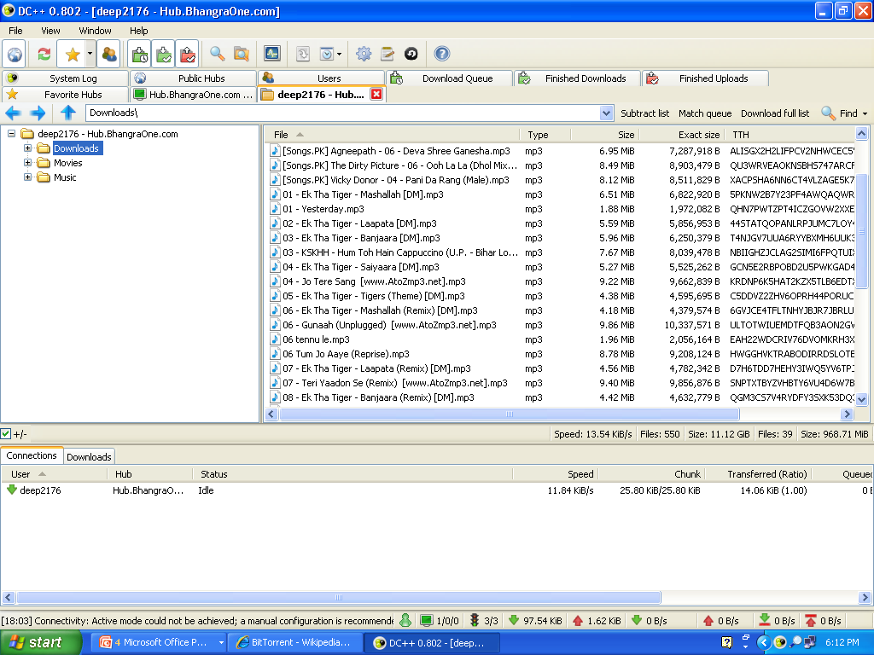
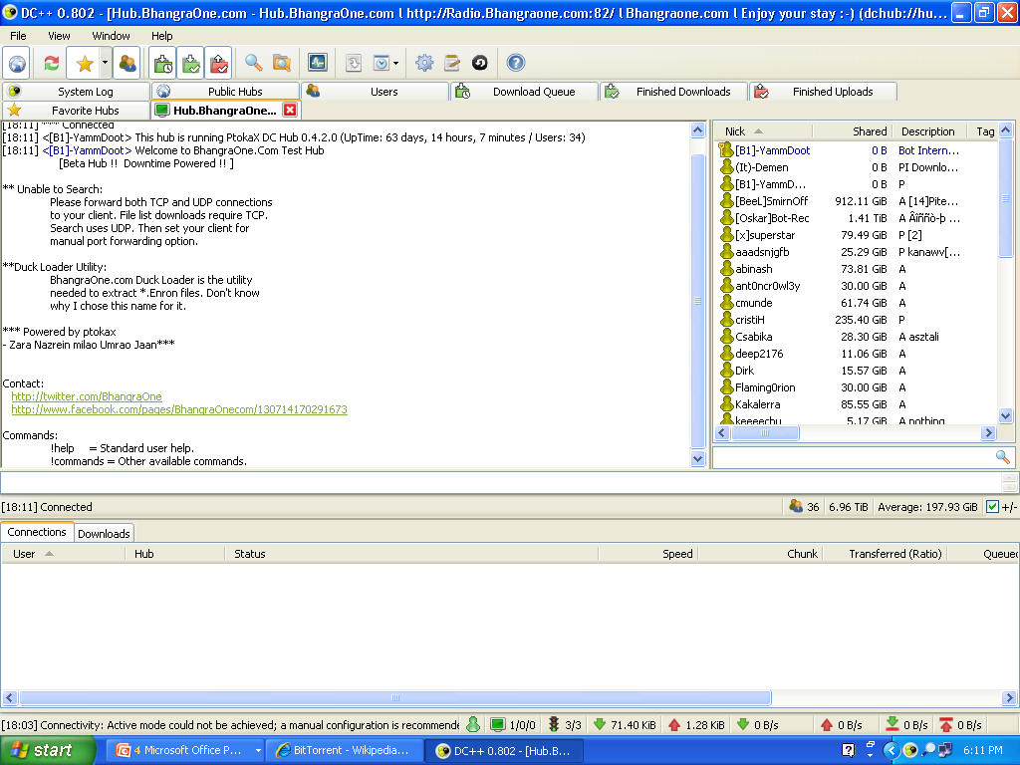
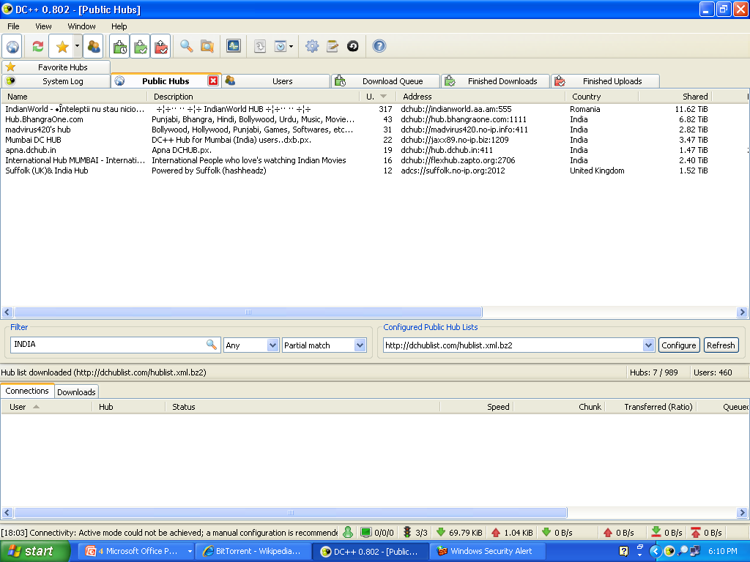



DC++
Client
HUBlist server
Client
HUB
Client
Signature
TCP
UDP
Client
$Send
$Search
$Connect
$Get
$MyInfo
$MyNick
$Direction
$Hello
$Quit
$Lock
$Key
$FileLength
$SR
$Pin
Client
SS ZG526, Distributed Computing

Slide 25
BitTorrent components
Torrent File
  Metadata of file to be shared
  Address of tracker
  List of pieces and their checksums
Tracker
  Lists peers interested in the distribution of the file
Peers
  Clients interested in the distribution of the file
  Can be “seeds” or “leachers”
SS ZG526, Distributed Computing

Slide 26
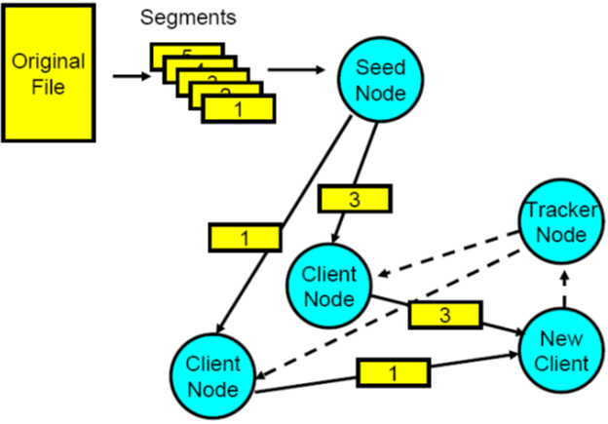
A BitTorrent Swarm
SS ZG526, Distributed Computing

Slide 27
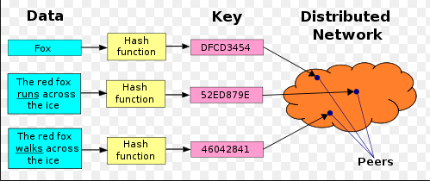
Structured P2P: DHT based
Key mapping in DHT
SS ZG526, Distributed Computing

Slide 28
Desirable properties of DHT
Keys mapped evenly to all nodes in the network
Each node maintains information about only a few other nodes
Messages can be routed to a node efficiently
Node arrival/departures only affect a few nodes
SS ZG526, Distributed Computing

Slide 29


Continued…
Set of Nodes
Keys of Nodes
Common Identifier
Space
Hashing
Connect
The nodes
Smartly
Keys of Values
Keys of Values
…
Hashing
Node Identifier
Value Identifier
Source: Le, Nguyen
SS ZG526, Distributed Computing

Slide 30
The Principle Of Distributed Hash Tables
A dynamic distribution of a hash table onto a set of cooperating nodes
node A
Key | Value
1 | Algorithms
9 | Routing
11 | DS
12 | Peer-to-Peer
21 | Networks
22 | Grids
node B
node C
node D
→Node D : lookup
Basic service: lookup operation
  Key resolution from any node
Each node has a routing table
  Pointers to some other nodes
Source: Le, Nguyen
SS ZG526, Distributed Computing

